Slide 1
A MACHINE LEARNING BASED CYBER ATTACK DETECTION MODEL FOR WIRELESS SENSOR NETWORKS IN MICROGRIDS
SUBMITTED BY
S Y SAPTHAGIRI | 20UCA132
Under the Guidance of
Ms.R.B.SOWMYA M.Sc.,
Assistant Professor
Department of Computer Applications

Slide 2
ABSTRACT
With the development of the Internet, cyber-attacks are changing rapidly and the cyber security situation is not optimistic. Machine Learning (ML) and Deep Learning (DL) methods for network analysis of intrusion detection and provides a brief tutorial description of each ML/DL method. Papers representing each method were indexed, read, and summarized based on their temporal or thermal correlations.
Because data are so important in ML/DL methods, they describe some of the commonly used network datasets used in ML/DL, discuss the challenges of using ML/DL for cyber security and provide suggestions for research directions.
The KDD data set is a well known benchmark in the research of Intrusion Detection techniques. A lot of work is going on for the improvement of intrusion detection strategies while the research on the data used for training and testing the detection model is equally of prime concern because better data quality can improve offline intrusion detection.
This project presents the analysis of KDD data set with respect to four classes which are Basic, Content, Traffic and Host in which all data attributes can be categorized using PCA WITH Modified Random Forest (MRF) and SVM . The analysis is done with respect to two prominent evaluation metrics, Detection Rate (DR) and False Alarm Rate (FAR) for an Intrusion Detection System (IDS).

Slide 3
EXISTING SYSTEM
Microgrid as a small-size power system covers both the generation and consumption sides which makes it possible to operate in two operation modes of grid-connected and is landed. Beside the physical layer including different Distributed Generations (DGs) and renewable energy sources, loads and storage units, a microgrid has an interconnected cyber layer mainly dealing with data transmission and decision making based on data gathering.
It cannot be applied when the contents of the messages are mostly non textual information. On the other hand, the “words” formed by mentions are unique, require little preprocessing to obtain (the information is often separated from the contents), and are available regardless of the nature of the contents.
DRAWBACKS
Dynamic approach is to alert the users
Smartphone users about suspicious profiles located
Detection of Random Link Attacks Malicious users create false

Slide 4
PROPOSED SYSTEM
The basic idea of our approach is to focus on the social aspect of the Grids reflected in the mentioning behavior of users instead of the textual contents.
We have proposed a probability model that captures both the number of mentions per Grid and the frequency of mentioned.
For each new Grid we use samples within the past time interval for the corresponding user for training the mention model we propose below.
We assign anomaly score to each Grid based on the learned probability distribution. The score is then aggregated over users and further fed into a change point analysis.
ADVANTAGES
The keyword-based methods on “International Conference on Smart Grid” data sets.
High in accuracy.
Minimum computation time
Fast and easily find anomaly users.

Slide 5
REQUIREMENT
HARDWARE
REQUIREMENTS
SOFTWARE
REQUIREMENTS
Operating System : Windows 10
Front End : Jupyter Notebook / Anaconda tool
Coding Language Python
Processor Type : AMD RYZEN 7
Speed : 4.40GHZ
RAM :16 GB RAM
Hard disk : 1 TB
Keyboard :101/102 Standard Keys
Mouse : Optical Mouse

Slide 6
MODULES
DATA PREPROCESSING:
The numerical values read from microgrid constructing around the smart meter readings of the electric consumers can determine the normal or un-normal behaviors in the system.
In The Case Of Cyber Security, The Proposed Anomaly Detection Method May Make Any Of These Four Decisions
COMPUTING THE LINK-ANOMALY SCORE:
Compute The Anomaly Score Of A New Grid by user actual time containing mentions to users reading the grid value in size.
We compute the probability with the training set T (t) u , which is the collection of Grids by user u in the time period [t−T, t]
CHANGE POINT ANALYSIS AND DTO:
This module is used to MRF coding, a coding criterion instead of the plug-in predictive distribution used.
MODIFIED RANDOM FOREST DETECTION METHOD:
MRF followed by DTO described in previous sections, we also test the combination of our method with Modified Random Forest-detection method.

Slide 7
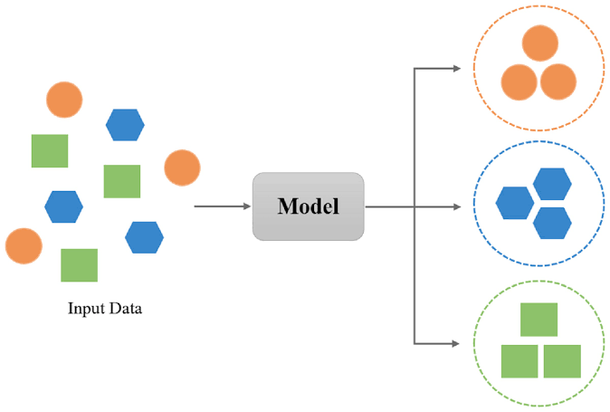
SYSTEM DESIGN
An assembly of parts designed to be added and removed from a larger system easily. The size of the dataset also affects the training effects of the ML and DL models.
MODULES

Slide 8
DATA BASE DESIGN
True Positive (TP): Positive samples correctly classified by the model;
False Negative (FN): A positive sample that is misclassified by the model;
False Positive (FP): A negative samples that is misclassified by the model;
True Negative (TN): Negative samples correctly classified by the model;
Further, the following metrics can be calculated from the confusion matrix:
Accuracy: (TP + TN)/ (TP + TN + FP + FN). Ratio of the number of correctly classified samples to the total number of samples for a given test data set.
Compounds | Predicted as positive | Predicted as negative
Labeled as positive | True Positive(TP) | False Negative(FN)
Labeled as negative | False Positive(FP) | True Negative(TN)

Slide 9
ARCHITECTURE DIAGRAM
Load KDD
Cup Dataset
Data Preprocessing
Feature selection
Rules for IDS
Point Prediction/
System initialization Attack
Trace Data
Read Grid Data
Read Meter Values
Detect Anomaly

Slide 10
DECISION TREE
Flow Data
Condition 1
Condition 2
Condition 2
TCP
Protocol
SFTP
Service
RTP
Access
Access
Access
NO
NO
NO
YES
YES
U2R
Probe
YES
Dos
U2R
R2L
DOS
R2L
DOS

Slide 11
USECASE DIAGRAM
Connect
LOAD
DATASET
RREQ Packet
New user
MRF
Algorithm
Forwarder
RREP Packet
Packet Transmission
Receiver
Forward

Slide 12
ACTIVITY DIAGRAM
Connect
Connect
RREQ Packet
RREQ Packet
MRF
Algorithm
MRF
Algorithm
RREP Packet
RREP Packet
Packet Transmission
Forward
Receive packet

Slide 13
INPUT SCREEN
==============================
Imbalanced Data with 10000 records
==============================
Duration Protocol_type ... Dst_host_srv_rerror_rate Class
0 0 tcp ... 0.0 back
1 0 tcp ... 0.0 back
2 0 tcp ... 0.0 back
3 0 tcp ... 0.0 back
4 0 tcp ... 0.0 back
... ... ... ... ... ...
9995 0 tcp ... 0.0 normal
9996 0 tcp ... 0.0 normal
9997 0 tcp ... 0.0 normal
9998 0 tcp ... 0.0 normal
9999 0 tcp ... 0.0 normal
[10000 rows x 42 columns]

Slide 14
INPUT SCREEN
BACK-->0
BUFFER_OVERFLOW-->1
FTP_WRITE-->2
GUESS_PASSWD-->3
IMAP-->4
IPSWEEP-->5
LAND-->6
LOADMODULE-->7
MULTIHOP-->8
NEPTUNE-->9
NMAP-->10
NORMAL-->11
PERL-->12
PHF-->13
POD-->14
PORTSWEEP-->15
ROOTKIT-->16
SATAN-->17
SMURF-->18
SPY-->19
TEARDROP-->20
WAREZCLIENT-->21
WAREZMASTER-->22

Slide 15
OUTPUT SCREENS
================================================================
PCA-RF Predicted class label values for Testing Dataset
================================================================
[ 9 9 11 11 20 9 9 11 11 11 9 11 11 9 9 11 11 9 9 11 11 11 0 9
11 11 11 9 18 11 11 11 9 11 9 18 1 11 11 9 11 0 11 15 20 11 11 11
11 11 11 11 20 11 11 11 9 20 18 11 18 9 11 11 21 11 9 9 21 9 0 11
11 9 11 9 5 9 5 9 11 11 11 9 11 5 11 20 11 9 11 11 11 20 11 11
9 11 11 9 9 11 11 11 11 11 14 15 11 11 11 11 11 0 21 9 11 9 11 11
.. .. .. .. .. .. .. .. .. .. .. .. .. .. .. .. .. .. .. .. .. .. .. .. .. .. .. .. .. .. .. .. .. .. .. .. .. .. .. ..
21 11 11 11 11 11 20 9 0 11 11 11 11 5 11 11 9 11 0 9 0 5 20 11
0 11 18 11 11 11 11 9 11 9 9 9 18 9 20 11]
PCA-RF Accuracy: 98.11075557935591 %
SVM Accuracy: 92.87808766147013 %

Slide 16
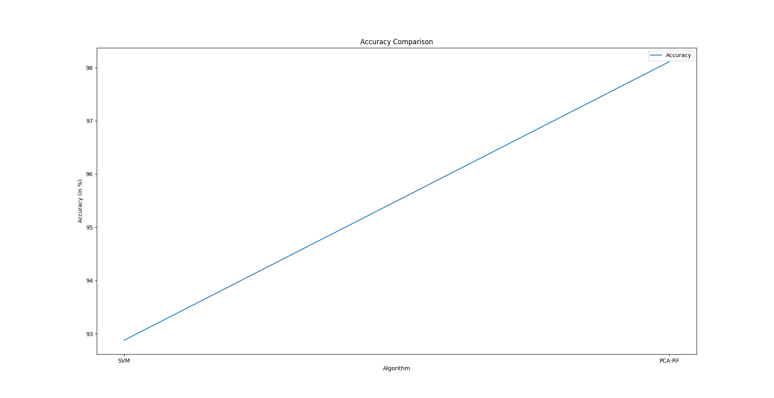
ACCURACY

Slide 17
CONCLUSION
In this project, we have proposed a new approach to detect the emergence of topics in a social network stream. The basic idea of our approach is to focus on the social aspect of the Grids reflected in the mentioning behavior of users instead of the textual contents. We have combined the proposed mention model with the MRF change-point detection algorithm . The Micro Grid Anomaly Detection proposed is an approximation to the NML code length that can be computed in a sequential manner. The MRF proposed further employs discounting in the learning of the AR models. As a final step in our method, we need to convert the change-point scores into binary alarms by thresholding. Since the distribution of change-point scores may change over time, we need to dynamically adjust the threshold to analyze a sequence over a long period of time. In this subsection, we describe how to dynamically optimize the threshold using the method of dynamic threshold optimization proposed. In DTO, we use a one-dimensional histogram for the representation of the score distribution. We learn it in a sequential and discounting way..

